Slide 1
ANALYSING AND MEASURING OF HEART RATE SIGNAL FROM FACIAL VIDEO
Guide: DR.L. SAIRAMESH Presented by,
P. Bhuvaneshwari
2019202008
MCA-Regular

Slide 2
Abstract
Heart beat measurement is one of the trivial approaches to identify human health state in medical industry. The project describes an implementation of Analyzing and measuring of Heart Rate Signal from facial video with health of computer vision.
Traditional way of measurement of heart beat method could take lot of time consuming and in convincing of physical touching.
In this project, video taken from any webcam then, each frame could take part of analysis, form that frame detect face using computer vision and based on color changing the signal data. Finally measure the heart beat taken signal data

Slide 3
PROPOSED SYSTEM
Computer vision based methods there is no need for a dedicated light source. These methods assume that the periodic circulation of the blood by the heart to the rest of the body, including the head, generates some periodic subtle changes to the skin color of the face and also generates some subtle head motions.
These motions are not usually visible to naked eyes but they can be viewed by techniques. These periodic changes to the skin colors and head motions are then utilized to measure heartbeat rate.
Face image of the subject is first found, by a simple camera. Then, it is separated into its color channels and each channel is tracked independently. Using Finite impulse response method to measure the heart beat based on the signals.

Slide 4
PLATFORM REQUIREMENTS
Hardware Requirements
•Processor: Intel(R) Core™ i5-2540M CPU @ 2.60GNz
•RAM: 4 GB
•Hard disk: 320GB
•Keyboard: Standard keyboard
•Monitor: 15 inch color monitor

Slide 5
Software Requirements
Operating system: Windows 10
Front End: Python
IDE: Jupiter Notebook

Slide 6
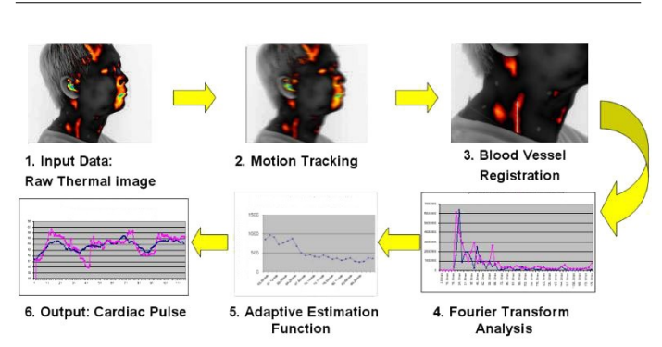
Using thermal camera

Slide 7
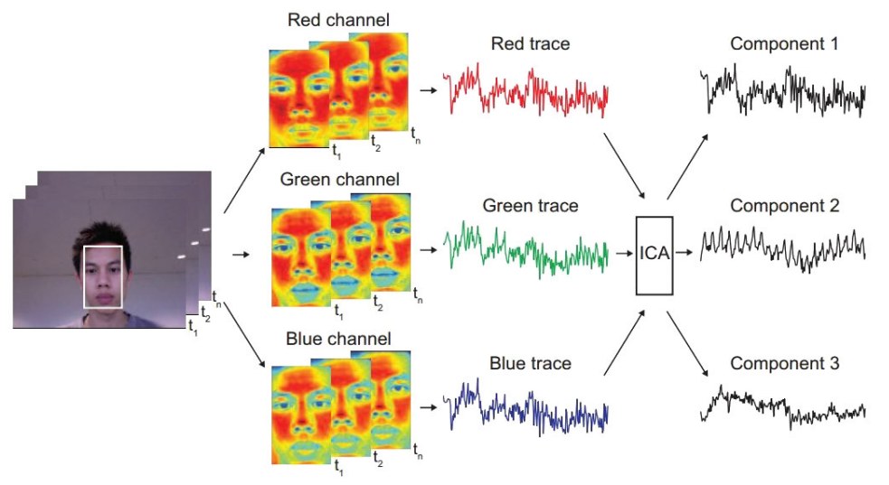
Using normal webcam

Slide 8
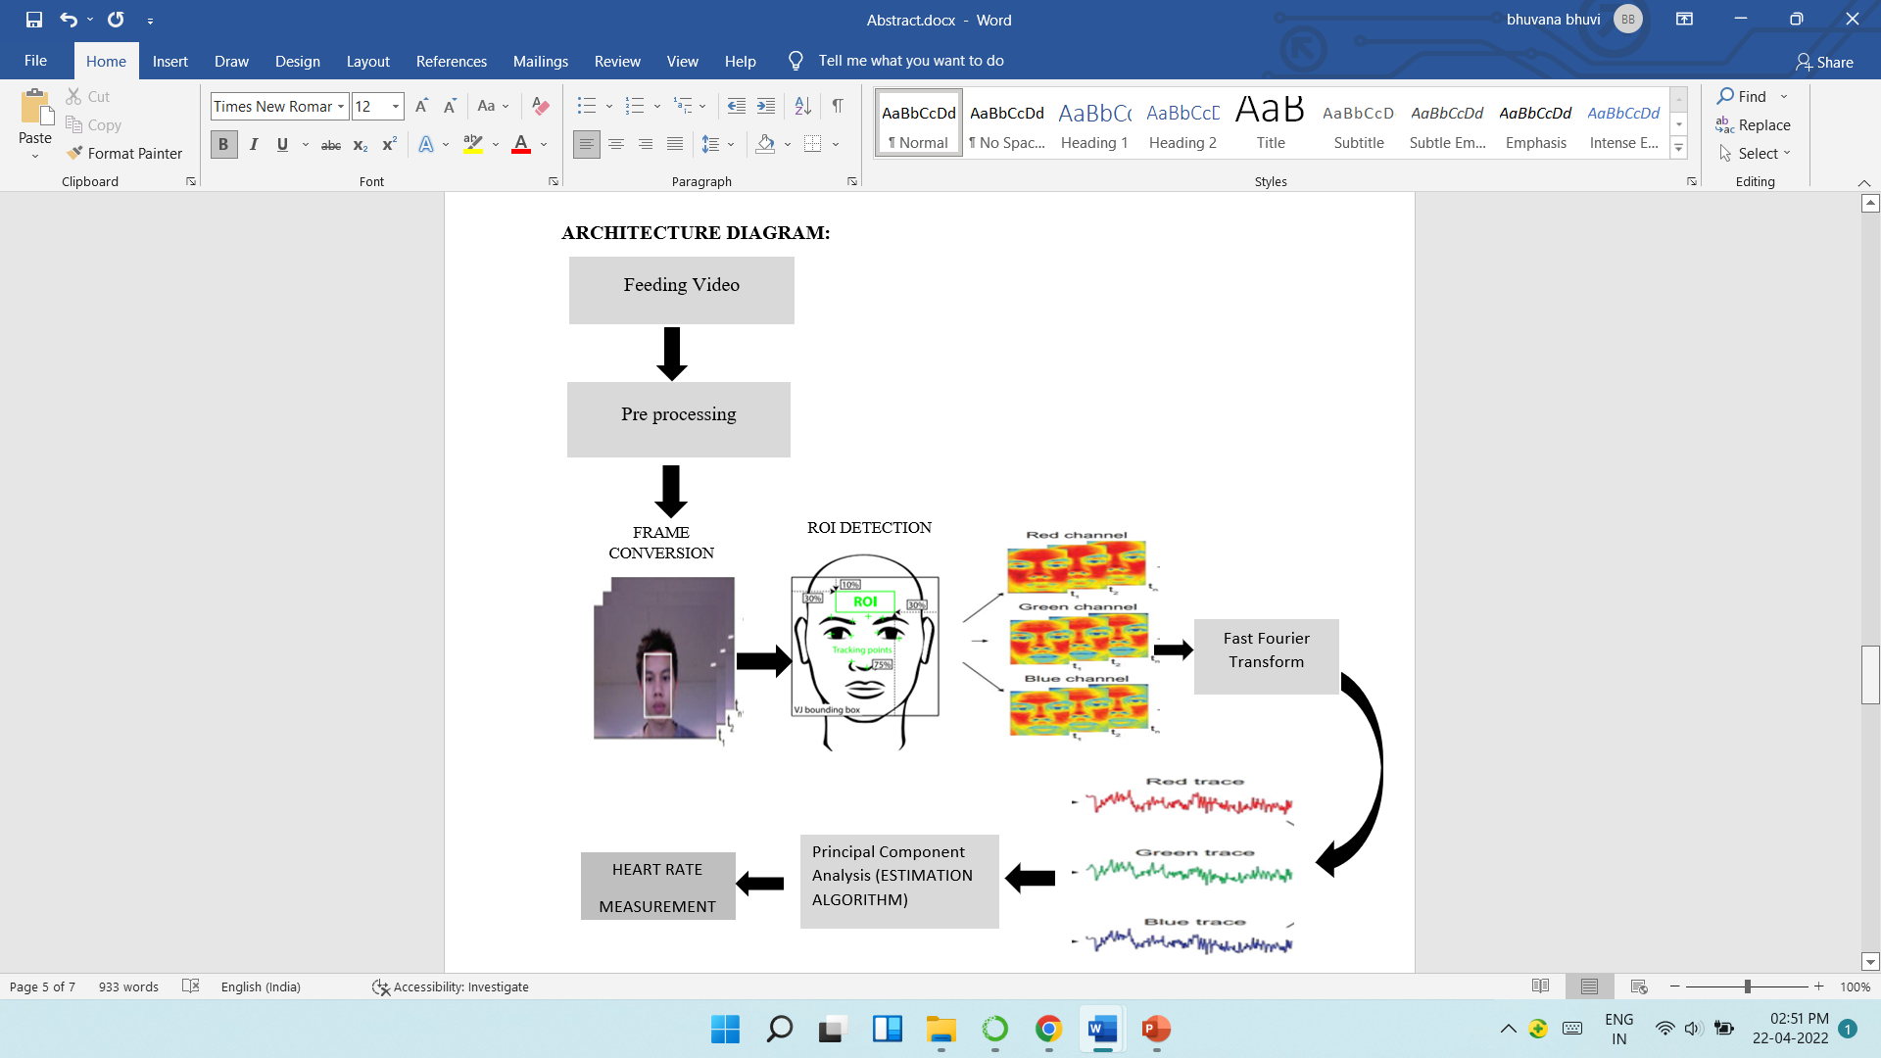
Architecture diagram

Slide 9
TOOLS AND TECHNIQUES
OpenCV is a great tool for image processing and performing computer vision tasks. It is an open-source library that can be used to perform tasks like face detection, objection tracking, landmark detection, and much more. It supports multiple languages including python, java C++
Face Detection Technique known as Haar Cascades is used.
Initially haar converts the image into grayscale image for ease of feature extraction. The algorithm first locates the face on the grayscale image and then maps onto the coloured image. Initially this algorithm draws the rectangle on the specified segment of the image.

Slide 10
TOOLS AND TECHNIQUES
Signal analysis:
The "Fast Fourier Transform" (FFT) is an important measurement method in the science of audio and acoustics measurement. It converts a signal into individual spectral components and thereby provides frequency information about the signal
PCA – Principal component analysis
PCA in ECG signal processing takes its starting point from the samples of a segment located in some suitable part of the heartbeat. The location within the beat diﬀers from one application to another and may in-volve the entire heartbeat or a particular activity such as different types of signal waves

Slide 11
THANK YOU !!
_

